Slide 1
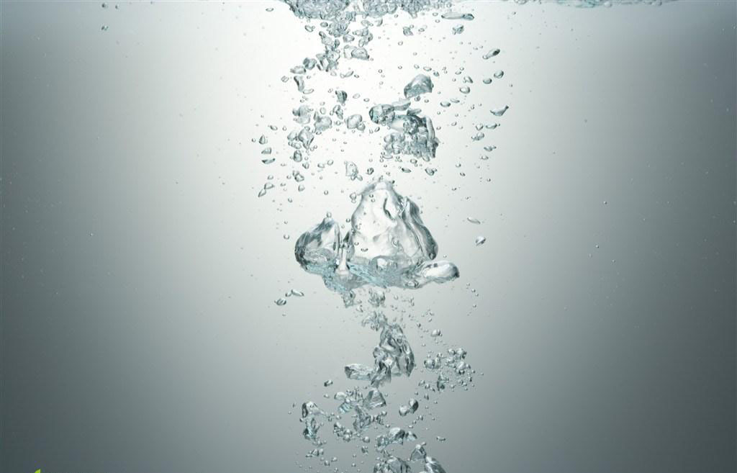
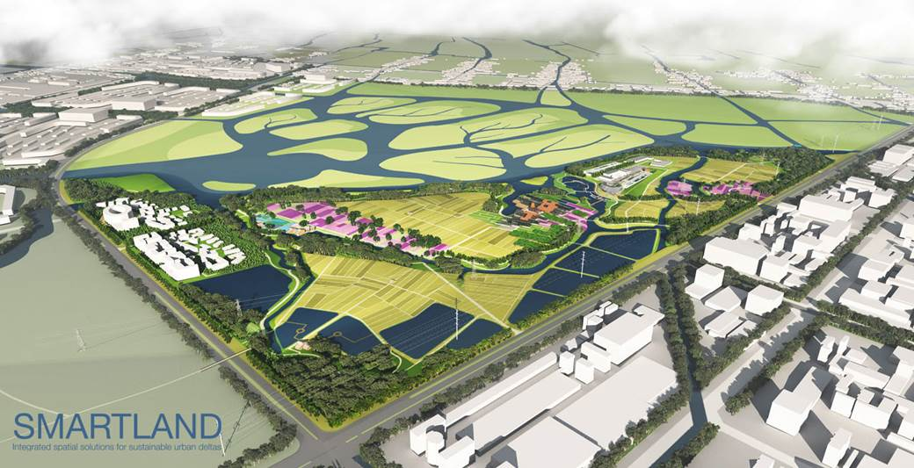
淡水生态学专题研讨会
Freshwater Ecology Seminars (FES)
(No. FES201703)
主 题: Yixing Infinity Park, a circular development in China
报告人: Klaas Jan Wardenaar (+ Roel Wolters and Léon Emmen)
SMARTLAND Integrated Spatial Solutions for Sustainable Urban Deltas ,
the Netherland
时 间: 2017年7月10日 (星期一) 上午9：00
地 点: 中国科学院水生生物研究所标本楼506会议室
组织者: 淡水生态学研究中心，中科院青促会水生所小组
Abstract
SMARTLAND is a Dutch office of landscape architecture, very much involved in sustainable and circular solutions to todays challenges. As a subtitle we use 'Integrated Spatial Solutions for Sustainable Urban Deltas', which very well describes our ambition and focus, based on over 20 years of professional experience in the Dutch Rhine River Delta, but also with about 6 years of experience in China.
Yixing Infinity Park fits very well in this focus. In short, this project deals about a combination of a 21st century, state-of-the-art Waste Water Treatment Plant with a Agricultural research centre, connected with a wetland watergarden and combined in an educational and recreational park. Location is the city of Yixing, near Shanghai, in an area between a new urban district and a big wetland development.
Efficient extraction of valuable materials and energy from the waste water is followed by using the regained fertiliser, CO2, and energy in the agricultural centre. Also the cleaned water is used, partly for drinking (!), partly for agricultural irrigation, partly for aquaculture and partly to feed the big wetland after being revitalized in the central watergarden.
The recreational structure is woven into this proces in such a way that people can explicitly experience and learn the essence of a circular economy. Therefore we named it Infinity Park. This concept has been used to design both the masterplan as well as the more detailed park elements.

